Slide 1
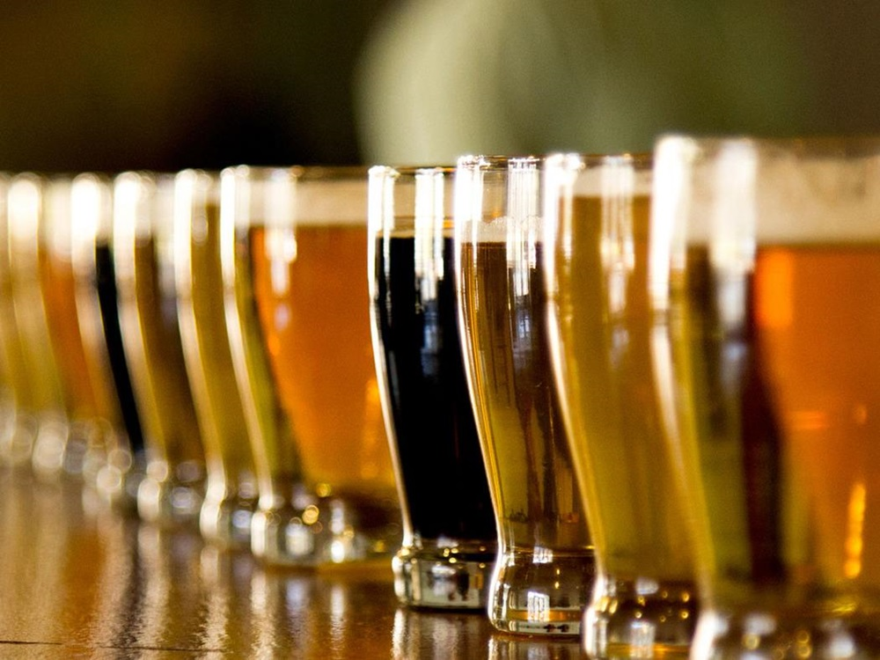
Beer Analytics
Hops and Dreams
Sabrina Purvis
Senthil Kumar
Akbar Thobani
Presenter:

Slide 2
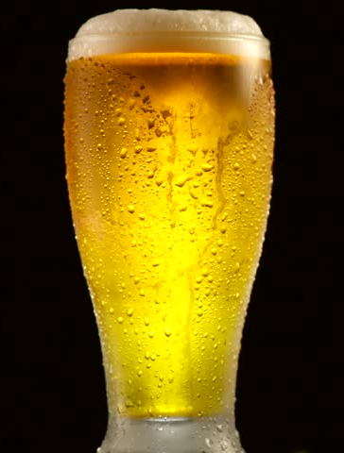
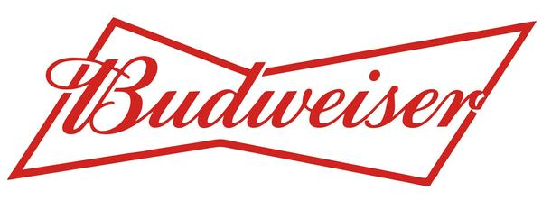
Agenda
Evaluating the competition
USA State by State comparison of competing breweries
ABV Analysis
IBU Analysis
Decision Making
Notes:
Summarize and change the format to Anz format

Slide 3

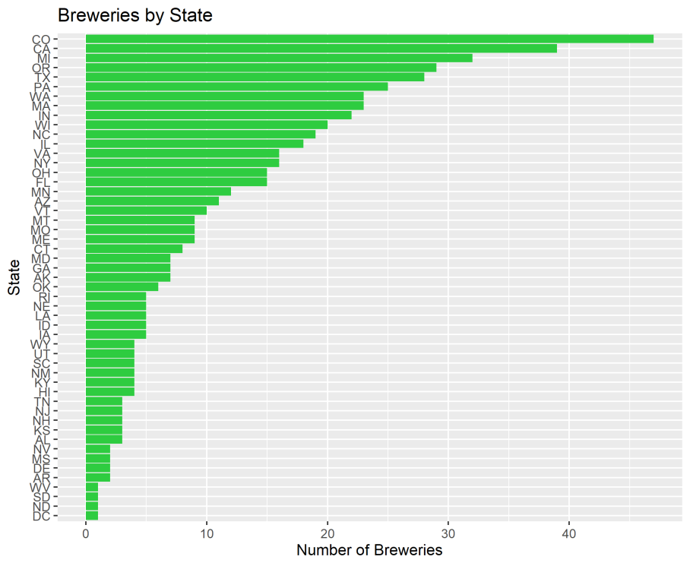
Evaluating the competition
Note the concentration of breweries on the Pacific Coast & in the North East

Slide 4
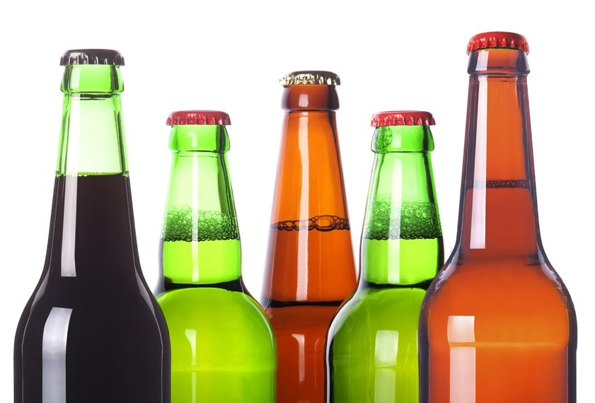
Data Cleanup
Total missing ABV values – 1005(42%)
Total missing IBU values – 62(3%)
Duplicates – 78(3%)
Notes:
The original beer dataset had 2410 listed beers.
Upon further inspection, the team recognized that the data had duplicate information. Identically named beers with only a beer ID variation were included it the original dataset. The team removed any instance where only the beer ID in the related observations was different.
We then discovered that the same beer also existed in multiple Ounce designations. Because we knew that we were evaluating ABV, IBU and their correlation, we removed any beer listed more than once to remove that bias in the dataset.
Finally, we had missing values in ABV and IBU. We simply removed those observations as well since we understood that we needed both variables for each observation to make the comparison.
Our final dataset consisted of 1341 observations

Slide 5
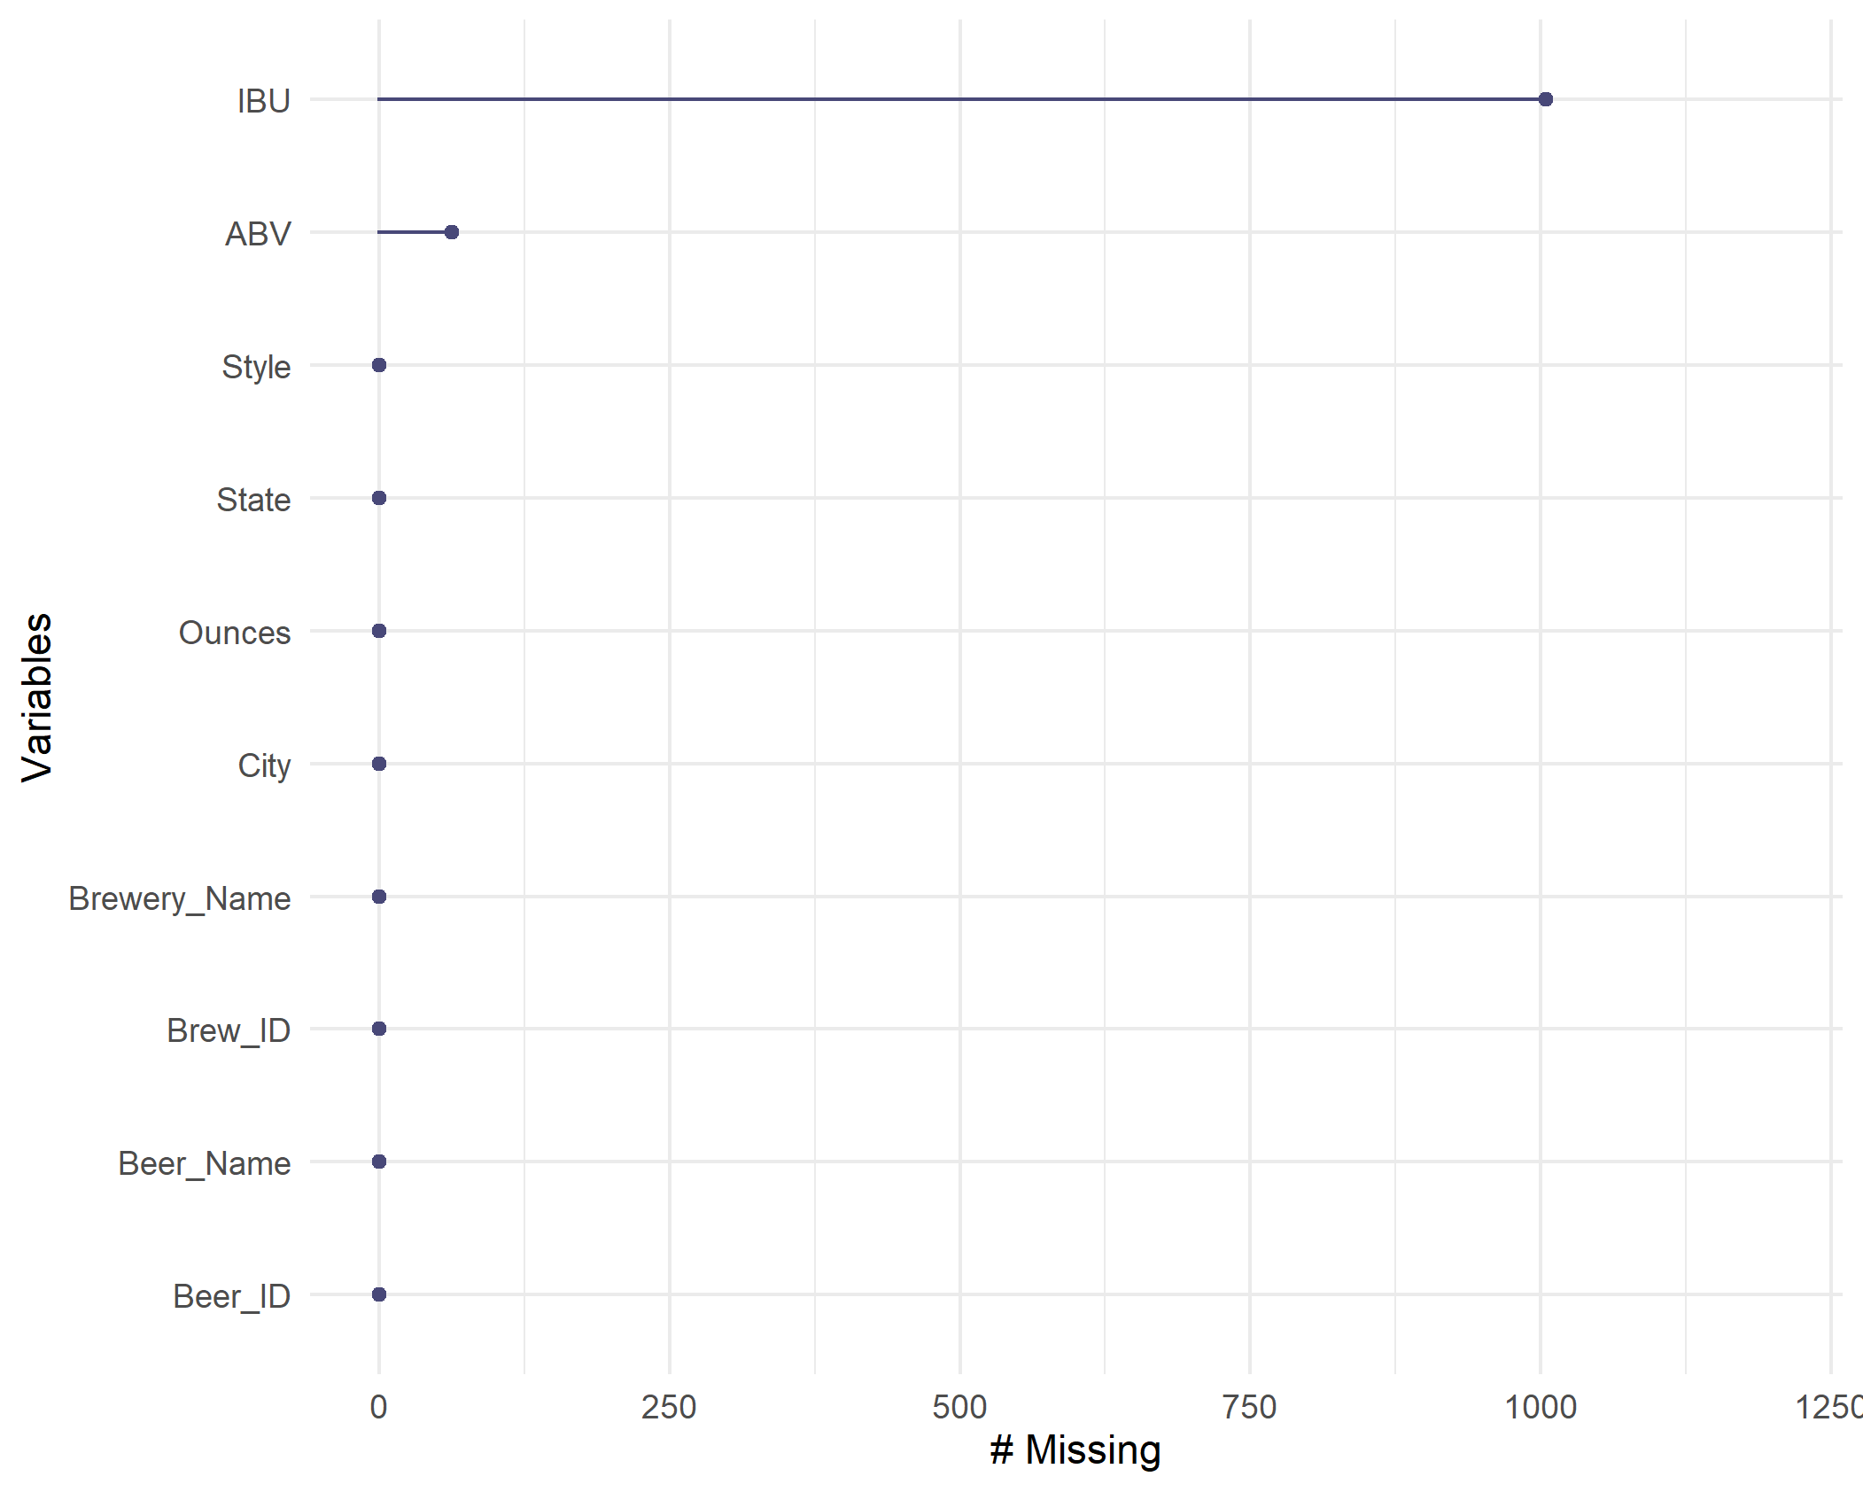
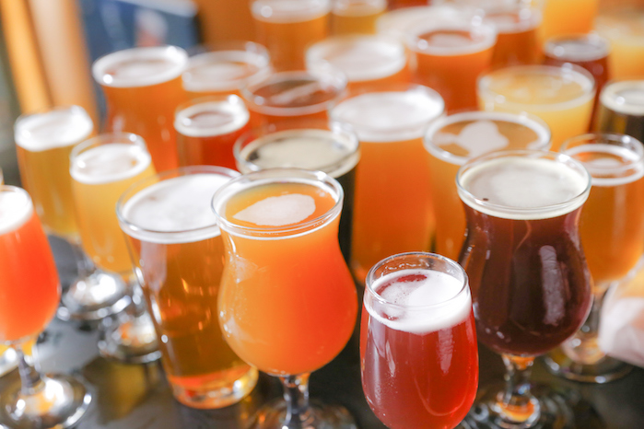
Missing Values

Slide 6
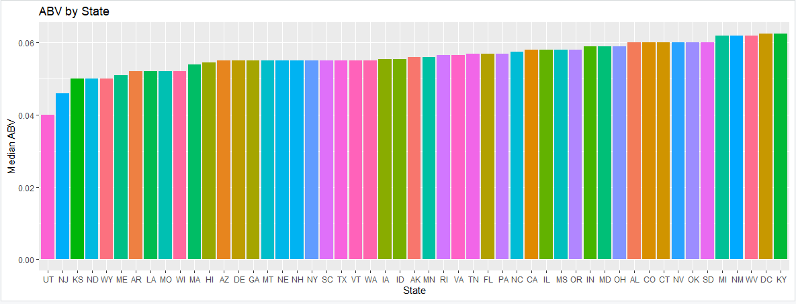
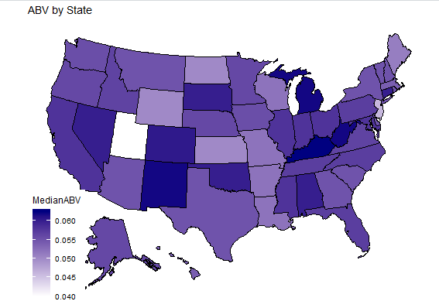
Understanding the trend of Alcohol by Volume
Median alcohol by volume is fairly consistent between 5% & 6.3%, unless you are in Utah or New Jersey

Slide 7
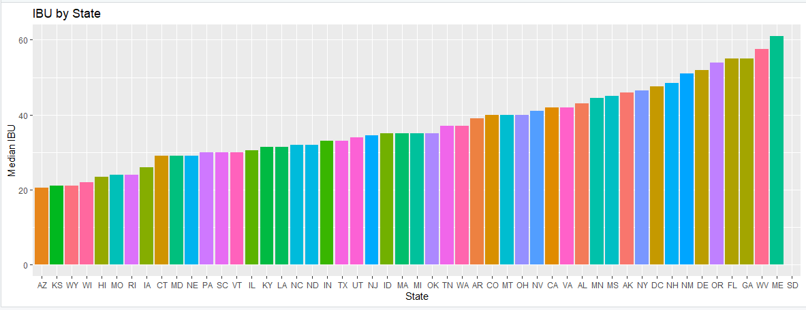
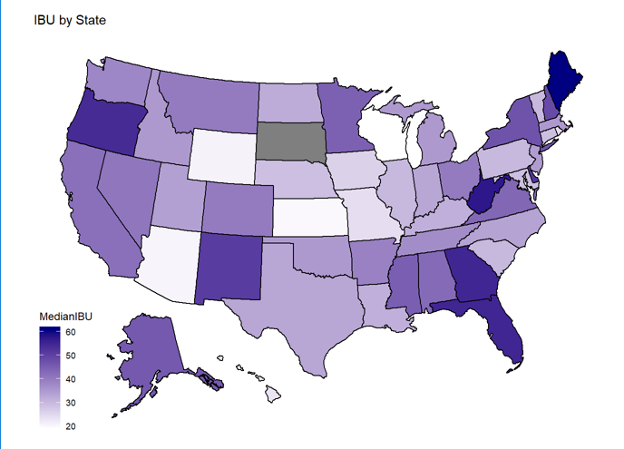
Understanding the Trend of International Bitterness Units
Median IBU is much more disparate
Median value ranges from just under 20 to just over 60

Slide 8
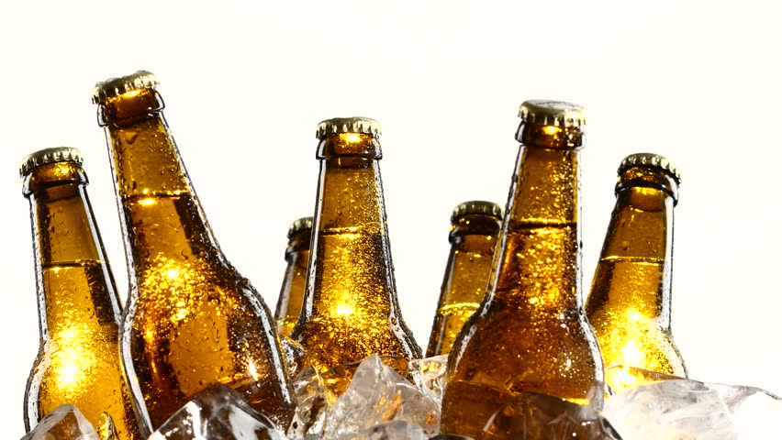
Max ABV & IBU by State
State with Max ABV Beer – CO (12.8%)
Lee Hill Series Vol. 5 Belgian Style Quadrupel Ale
State with Min ABV Beer – CA (0.1%)
Scotty K NA
State with Max IBU Beer – OR (138)
Bitter Bitch Imperial IPA
State with Min IBU Beer – CA (4)
Summer Solstice

Slide 9
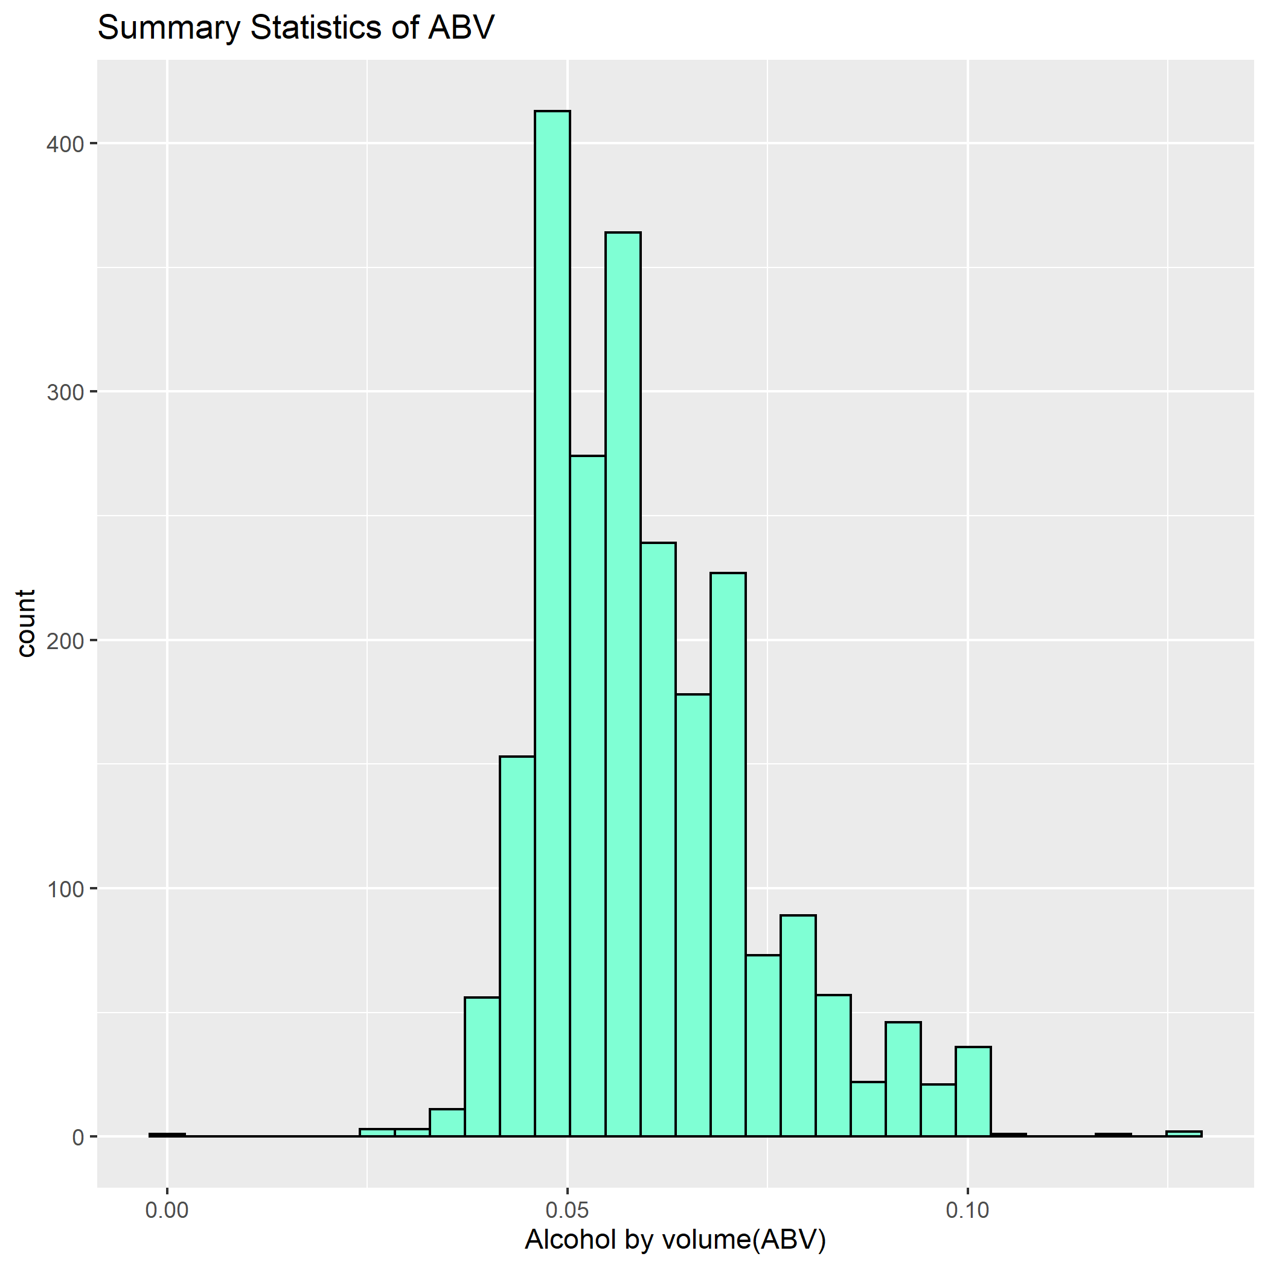
Analyzing Summary statistics and distribution of ABV variable
Min. 1st Qu. Median Mean 3rd Qu. Max. NA's
0.00100 0.05000 0.05700 0.05993 0.06800 0.12800 62
From the summary statistics, it can be inferred that the ABV of our craft beers dataset follows a normal distribution because the median and the mean values are very close.
There is a slight right skew to the data. Also from the Median One thing to note is that 75% of all the beers have a 5% ABV or more. However, the interquartile distance is only 1.8% suggesting that 50% of the data is bounded between 5% and 6.8% ABV.
It is also important to remember that missing values are not included in the summary statistics, and there's a possibility that this representation may not be accurate.
Notes:
We next evaluated some statistics specifically around Alcohol by Volume. As you can see in the chart, beer is a pretty predictable beverage from this standpoint. 75% of the beers evaluated have a 5% ABV or higher and there is almost no difference between the median and mean ABV. This information helps to validate that ABV is a dependable measure to use when completing further analysis.

Slide 10
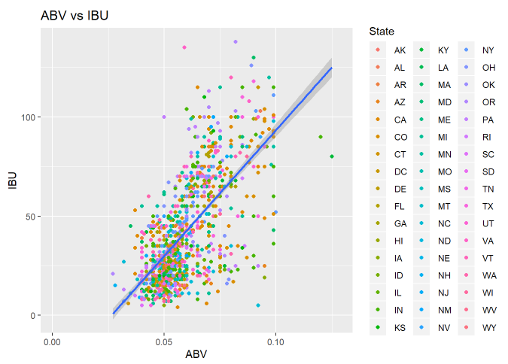
Further Dive into ABV and its influence
66.55% variation in the IBU of craft beers explained by ABV
For every 10 point increase in the IBU value, there is an increase of .34% units in the ABV
Note: 40% of the IBU data is missing.
Notes:
Because Alcohol by Volume and International Bitterness Units are both influential factors in taste and popularity of any given beer, we investigated whether or not they were also influential to each other. As shown in the graphic, there is certainly correlation between the alcoholic content of the beer and it’s IBU score. To explain this further, for every 10 points a beer increases on the IBU scale, the Alcohol by volume also increases by .34%.

Slide 11
Understanding How Style Matters
Relationally, IBU and ABV matter to each other when determining the style of beer you plan to brew.
Evaluating IPA vs other Ales Only
Type of Beer | Accuracy | Sensitivity | Specificity
IPA / Other Ales | 90.00% | 86.21% | 92.86%
Evaluating All Styles of Beer
Type of Beer | Balanced Accuracy | Sensitivity | Specificity
IPA | 86.84% | 83.90% | 89.79%
Other Ales | 63.51% | 62.50% | 64.53%
Non-Ales | 62.83% | 39.66% | 86.01%
Notes:
Because we have confirmed that ABV and IBU are interrelated, we next evaluated if the style of beer was also influenced by this correlation.
Initially, we compared only the Ales. We looked at IPA versus everything else that was an Ale. We also then pulled in the Non-Ale beers to validate our assumptions.
Looking at our classification, style definitely plays – if you are an IPA. IPA’s are strongly predictable based on ABV and IBU.
They are a distinct type of beer
From this analysis, we further confirm that there’s correlation between bitterness and alcohol content of beer.
We can assume that there are other factors that are not accounted for in this case study that may influencing this factor. It would be interesting to know what other components are involved in the brewing process and if those data can be brought in to see if there’s any change in this relationship.
Also further study could be made by filling in the missing ABV and IBU data to see what influence that might produce in this relationship.

Slide 12
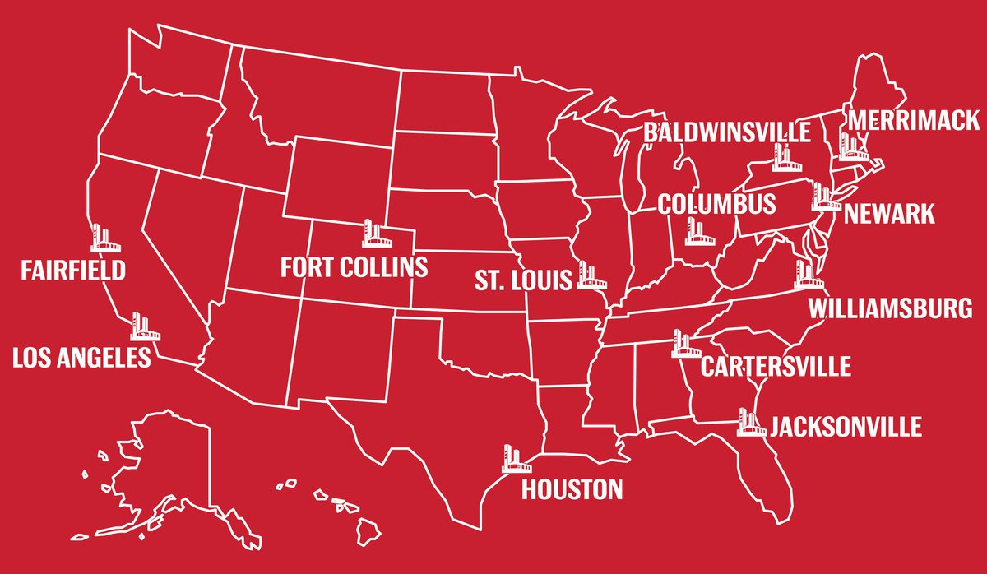
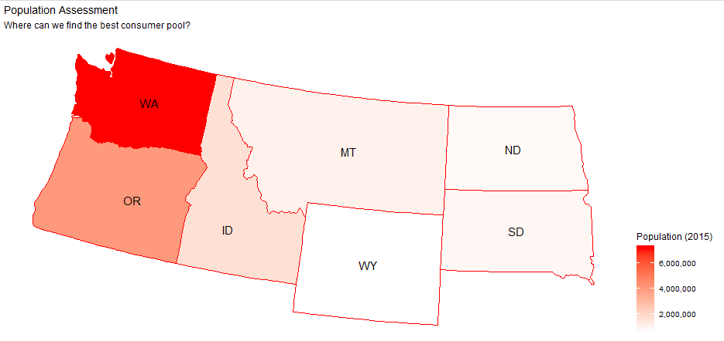
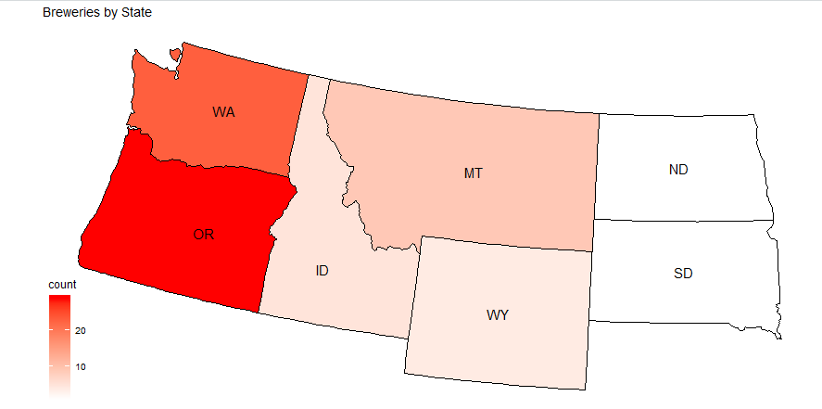
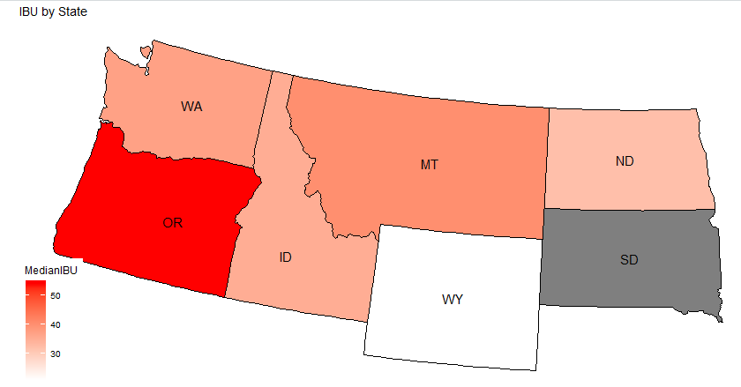
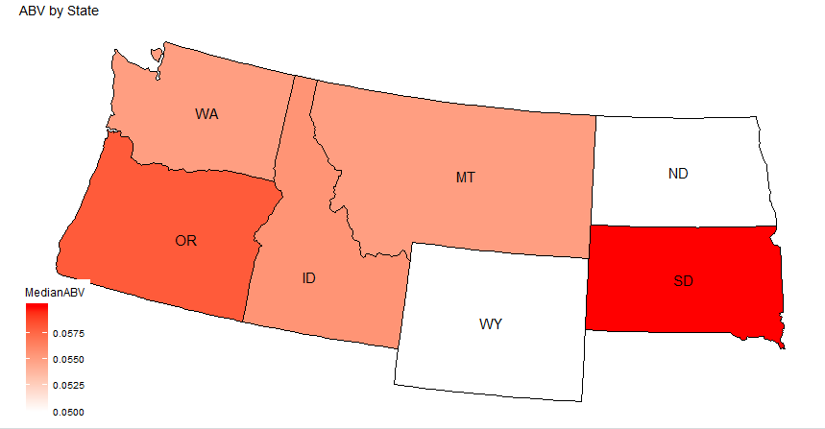
Expansion Proposal
Budweiser Brewery Locations
Washington
23 Breweries
5.5% Median ABV
37.0 Median IBU
Budweiser comparables
5.0% ABV
7.0 IBU
Notes:
We know that part of running a successful business means expansion into new markets. Budweiser currently manages 12 breweries across the United States. What our team identified is that the northwest United States is an area of untapped potential.
We’ve presented here a few key items that drive our recommendation. Washington is the most populous state in this area and as you know, you need a wide consumer network to sell beer. Oregon would be a secondary option, but they have the most breweries in this region already with less of a population to draw from. Because of this, we recommend consideration of Washington as your next location for a brewery.
As we have discussed at length, the Alcohol by volume and IBU are related and important factors in beer consumption.
To be successful in Washington, you need to consider highlighting a beer that mimics the tastes of Washington. Stella Artois, another Anheuser-Busch brew, reports a 5.2% ABV with an IBU of 37, making it a great flagship brew to consider in this new-to-you market.

Slide 13
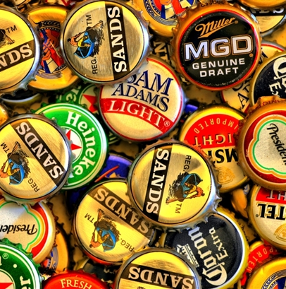
Thank You
Notes:
Thank you very much for your time. We at Hops and Dreams look forward to our next opportunity to help propel your business forward.

